Slide 1
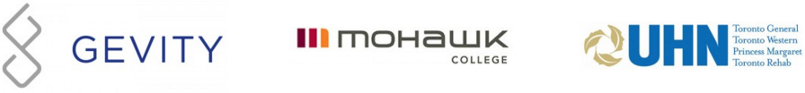
FHIR for Executives (abbreviated for FHIR North)
Lloyd McKenzie
April 27, 2016

Slide 2
This presentation
Can be downloaded here:
http://gforge.hl7.org/svn/fhir/trunk/presentations/2016-04%20FHIR%20North/FHIR%20for%20Executives%20-%20short.pptx
Use “anonymous” and email address to logon
Is licensed for use under the Creative Commons, specifically:
Creative Commons Attribution 3.0 Unported License
(Do with it as you wish, so long as you give credit)

Slide 3
WHY FHIR?

Slide 4
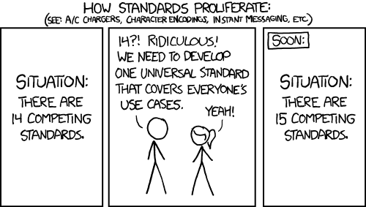
http://xkcd.com/927

Slide 5
The Need
Has been a need to share healthcare information electronically for a long time
HL7 v2 is nearly 30 years old
Increasing pressure to broaden scope of sharing
Across organizations, disciplines, even borders
Mobile & cloud-based applications
Faster – integration in days or weeks, not months or years

Slide 6
What we have – v2
Works relatively well within institutions
But
Legacy, custom syntax (learning curve, tools)
Messaging design limits architectures
Doesn’t scale well across organization boundaries
Security/privacy infrastructure is minimal
A potpourri of segments and fields with no means to distinguish the common from edge case

Slide 7
What we have – v3
Newer technology and semi-robust reference model, but
Steep learning curve
Primary implementations by those with $$$$s
No inter-version wire compatibility
International specifications are too abstract, regional implementations don’t interoperate

Slide 8
What we have - CDA
Broad implementation, human-to-human interoperability, but:
Still a very steep learning curve
Interoperability beyond a human-to-human level is still a challenge, even with templates
Document architecture doesn’t fit all problems
Still a diversity of implementations
Extensibility is difficult

Slide 9
So I should drop everything and use FHIR?
Tossing functioning systems the instant a promising newcomer appears is not generally a wise strategy
There’s room for something better
FHIR tries to fill that gap
Market will decide whether FHIR survives, coexists or replaces other products
Notes:
There are flaws in what exists
There are new use-cases not being met

Slide 10
Complexity Model
Snomed
HL7 V3
openEHR
WS
CDA
Difficulty (log)
XML
HL7 v2
How?
HTTP / HTML
Text
Semantic Depth

Slide 11
What is FHIR?
And how is it different?

Slide 12
The acronym
F – Fast (to design & to implement)
Relative – No technology can make integration as fast as we’d like
H – Healthcare
That’s why we’re here
I – Interoperable
Ditto
R – Resources
Building blocks – more on these to follow

Slide 13
FHIR – Key differences
Focus on Implementers
Target support for common scenarios
Leverage cross-industry web technologies
Require human readability as base level of interoperability
Make content freely available
Support multiple paradigms & architectures
Demonstrate best practice governance
Notes:
We don’t actually have a formal manifesto, but these are the principles we adhere to.

Slide 14
Support “Common” Scenarios
80%
Inclusion of content in core specification is based on “80%” rule
Only include data elements we are confident that most (~80%) of normal implementations using that resource will make use of
Other content in extensions (more on this later)
Easy to say, governance challenge to achieve
Resources are simple and easy to understand & use
Notes:
Design by constraint failed – years to develop, what was produced required yet more design to be implementable and after that might not be interoperable
How to determine the 80%? Look to existing specs – v2, v3, CDA templates, OpenEHR, jurisdictional projects, what implementations we’ve seen
If not sure, err on the side of “not in for now”
Note: not 80% of instances, 80% of implementations
Challenges with “raising the bar”
What happens when there aren’t many/any implementations?

Slide 15
Example – ISO AD type
isNotOrdered, updateMode, flavorId, nullFlavor, controlAct root & extension, validTime low and high, useable period (GTS – no room on the slide), use
home, primary home, vacation home, workplace, direct, public, bad, physical, postal, temporary, alphabetic, ideographic, syllabic, search, soundex, phonetic
0..* parts, each with:
value, code, code system, code system name, code system version, language, type:
address line, additional locator, unit identifier, unit designator, delivery address line, delivery installation type, delivery installation area, delivery installation qualifier, delivery mode, delivery mode identifier, street address line, building number, building number numeric, building number suffix, street name, street name base, street type, direction, intersection, care of, census tract, country, county or parish, municipality, delimiter, post box, precinct, state or province, postal code, delivery point identifier
Notes:
How many of your systems have user interfaces that support even ¼ of this?

Slide 16
Example – FHIR Address
isNotOrdered, updateMode, flavorId, nullFlavor, controlAct root & extension, validTime low and high, useable period (low, high) (GTS – no room on the slide), use
home, primary home, vacation home, workplace, direct, public, bad, physicalvisit, postal, temporary, alphabetic, ideographic, syllabic, search, soundex, phonetic, old
0..* parts, each with:text
value, code, code system, code system name, code system version, language, type:
address line, additional locator, unit identifier, unit designator, delivery address line, delivery installation type, delivery installation area, delivery installation qualifier, delivery mode, delivery mode identifier, street address line, building number, building number numeric, building number suffix, street name, street name base, street type, direction, intersection, care of, census tract, country, county or parish, municipalitycity, delimiter, post box, precinct, state or province, postalCode, delivery point identifier
Notes:
This is what happens when you apply the 80% . . .

Slide 17
Won’t extensions break interoperability?
The 80% + narrative helps provide “base” interoperability
For “robust” interoperability
Profile – constrains structure
Conformance – constrains behavior
Needed to claim “I’m FHIR conformant”
Notes:
1000s of extensions, everyone supports different things, don’t know what anyone does
Not everyone will support the 80%, but most will
“What most systems support” (and thus what you should probably support too) encourages base interoperability
Human readable fallback
Profile – what elements are supported, registries available
Conformance – REST operations, documents, messages, services

Slide 18

Human Readable
Clinical Documents has both narrative and data
The data / narrative dynamic exists throughout the process
In FHIR, every resource can (should) have a human-readable expression
Can be direct rendering or human entered
Notes:
Even when you think your target will understand all the encoded data, reality is data often gets shared beyond the originally intended context
Allow for exceptions for things like automated device readings, etc.

Slide 19
FHIR & Cost of Integration
These factors will drive down the cost of integration and interoperability
Easier to Develop
Easier to Troubleshoot
Easier to Leverage in production
More people to do the work (less expensive consultants)
Competing approaches will have to match the cost, or disappear – effect is already being felt

Slide 20
Future impact of FHIR
Impact of FHIR on the market:
Drive interoperability prices down
Higher Expectations
Increased spend on integration (N x 2!)
Freeing data can enable new business models and new companies
Notes:
How much integration do you need? Nx2 – twice what you have

Slide 21
FHIR Resources

Slide 22
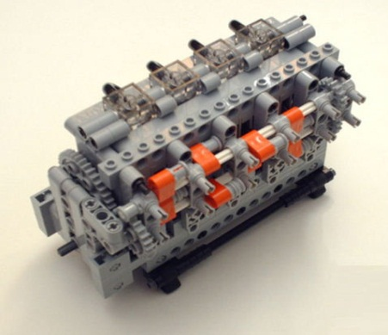
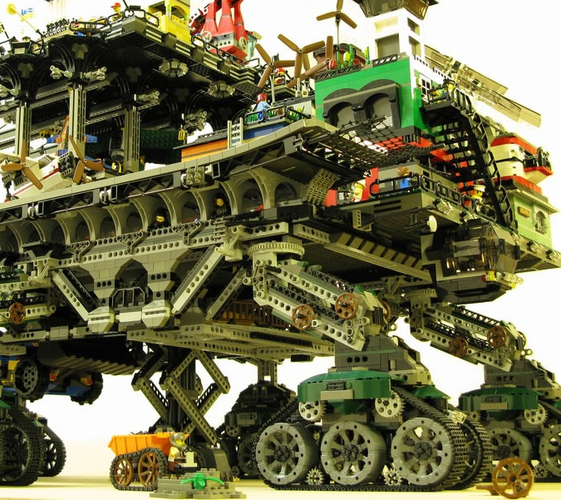

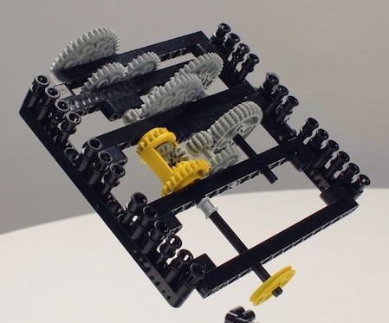
FHIR solutions
Resources
Extensions
Solution
+
=
Notes:
Resources are building blocks, but useful in their own right
Extensions supplement what resource doesn’t cover
Solutions can be simple or complex

Slide 23


Resources
“Resources” are:
Small logically discrete units of exchange
Defined behavior and meaning
Known identity / location
Smallest unit of transaction
“of interest” to healthcare
V2: Sort of like Segments
V3: Sort of like CMETs

Slide 24
What’s a Resource?
Examples
Non-examples
Administrative
Patient, Practitioner, Organization, Location, Coverage, Invoice
Clinical Concepts
Allergy, Condition, Family History, Care Plan
Infrastructure
Document, Message, Profile, Conformance
Gender
Too small
Electronic Health Record
Too big
Blood Pressure
Too specific
Intervention
Too broad
100-150 total - ever
Notes:
And few systems will ever see more than 40-50

Slide 25
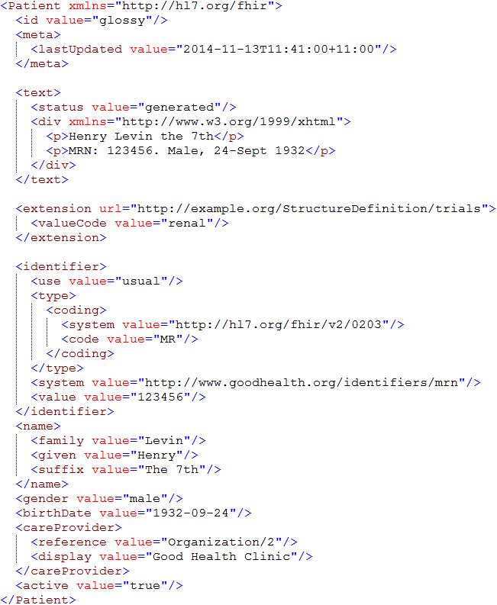
Identity & Metadata
Human Readable Summary
Extension with reference to its definition
Standard Data Content:
MRN
Name
Gender
Date of Birth
Provider

Slide 26
What’s in a resource definition?
Each resource defines:
What elements are part of “core”
Names
Definitions
Cardinality
Code lists
Mappings (to RIM, v2 and other specs)
Constraints
All in a computable form
Create spec, schemas, reference implementations

Slide 27
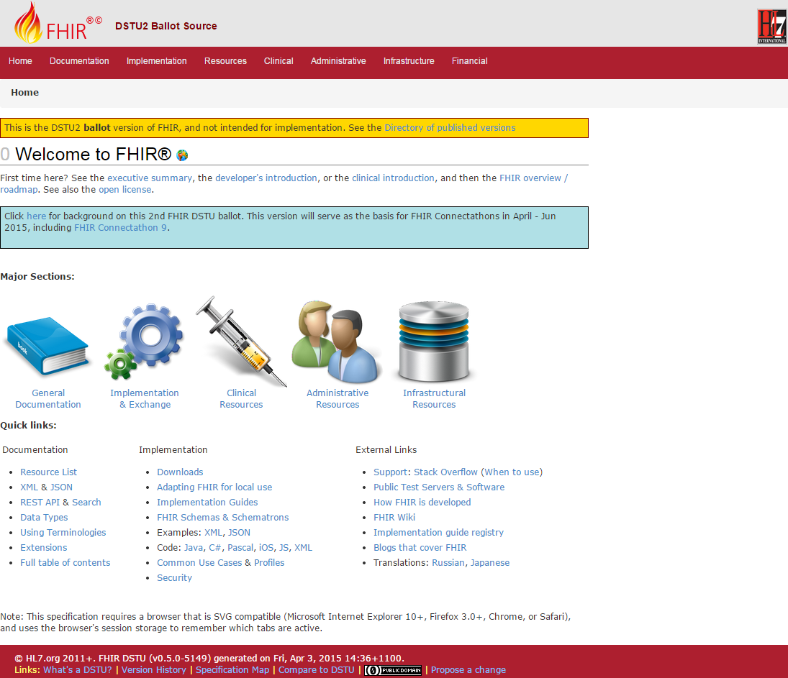
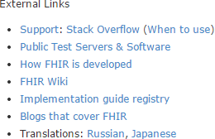
(FHIR home)
hl7.org/fhir
Notes:
Published as HTML
Published using validation process that performs consistency checks – like a software build
Really shouldn’t require much guidance to read, but a few things to call out
Objective of spec is developer can skim and decide in < day

Slide 28
FHIR Timeline (planned)
First Draft
1st
STU
~ 2nd
STU
~ 3rd
STU
~ 1st
Norm?
. . .
2011
2012
2013
2014
2015
2016
2017
2018
2019
2020
Notes:
Note that dates are subject to change based on resources and the standards process

Slide 29
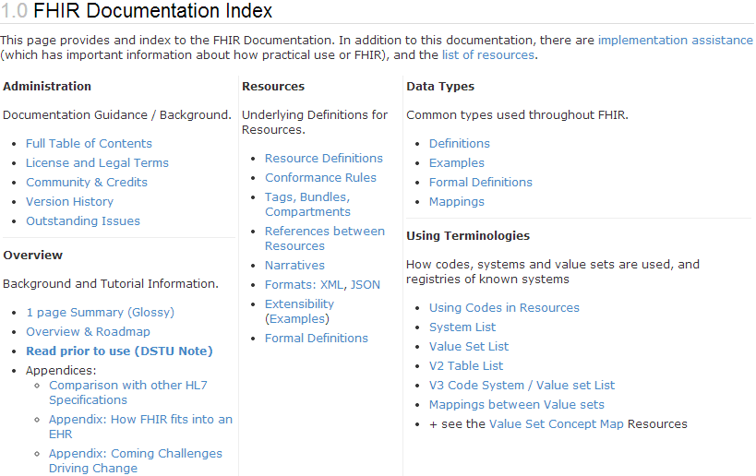
What does STU mean?
“…all aspects of the FHIR specification are potentially subject to change
Notes:
Split resources, dropped resources, changed JSON and XML syntax, added and changed elements, renamed data types

Slide 30
Maturity levels
Intended to indicate level of stability
FMM1 – Resource is “done”, no build warnings
FMM2 – Tested at approved Connectathon
FMM3 – Passes QA, has passed ballot
FMM4* – Tested across scope, published, prototype implementation
FMM5* – 5 distinct production implementations, multiple countries, 2
Non-compatible changes at level 4 and 5 will face increased hurdles

Slide 31
Normative FHIR
Will include
Core specification
Structural resources
Subset of other resources
Some resources won’t go normative right away
Future releases
Add more resources
Add profiles on existing resources
May add elements to resources
Very rare

Slide 32
Using FHIR

Slide 33
Where can FHIR be used?
Classic in-institution interoperability
Back-end e-business systems (e.g. financial)
Regional Health Information Organizations (RHIO)
National EHR systems
Social Web (Health)
Mobile Applications
Near
Term

Slide 34
Implementation during STU
FHIR is new
No commitment yet to backward compatibility
No stability guarantee until 2018+
Some resources didn’t exist in initial version
Appointment, Referral, Insurance, Nutrition, etc.
However, implementers are choose to build with it anyhow and have continued to do so

Slide 35
Who’s working with FHIR?
>200 organizations declared
attended a Connectathon and/or
signed up on wiki
Aware of many others not on either list
Almost 500 participants on the FHIR Implementer’s chat
http://chat.fhir.org
20+ countries involved so far

Slide 36
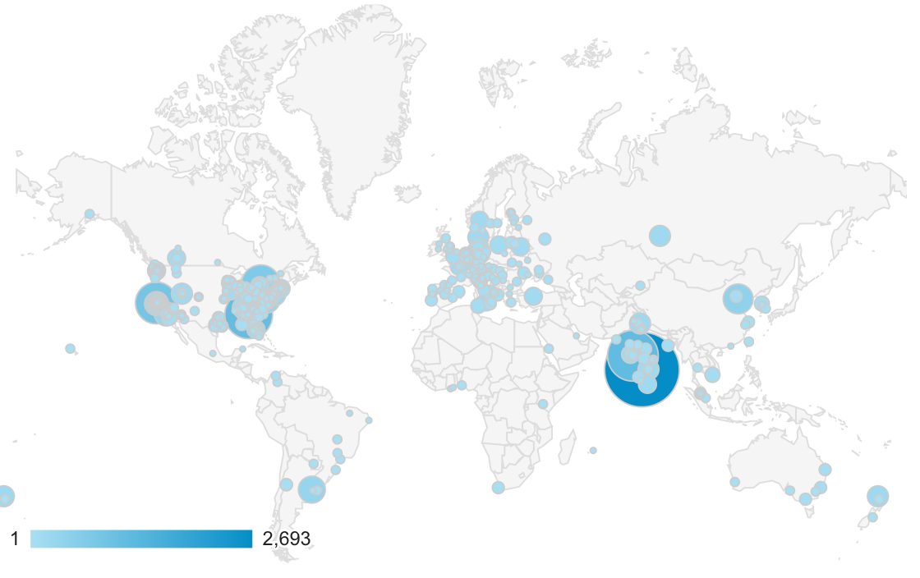
Who’s using FHIR?
Systems accessing HAPI server in 2015
Notes:
Jan->mid Nov. 2015 – unique systems accessing the HAPI test server

Slide 37
Who’s using FHIR?
SDOs
IHE: MHD (mobile XDS), PIX/PDQ, CMAP, RECON, Accountable Order
DICOM, W3C
Governments
US (ONC), UK NHS, Lithuania, Ontario, WHO, …
Vendors
Big: Epic, Cerner, McKesson, Meditech, HP, IBM, …
Small: Lots of start-ups, app vendors
Care delivery organizations
Mayo, Intermountain Healthcare, Kaiser, UHN
Payors

Slide 38
FHIR & CDA
HL7 developing FHIR profiles for CCDA
Will have key ones present in next STU
HL7 project to define “Clinical Document Architecture” in FHIR
Can now use FHIR profiling tools to validate CDA instances
At least 3 projects looking at providing automated transformation between CCDA and FHIR

Slide 39
Case study 1
Who
Oridashi – Australian eHealth consultant/vendor
What
Use FHIR as primary care EMR integration interface to two leading primary care CISs.
Enables decision support, referral and personal health record portals.
When
Full production Fall, 2014

Slide 40
Case Study 2
Who
Healthcentrix.co – U.S. cloud-based PHR start-up
What
Community portal, PHR, mobile health assistant, device aggregator
XDS persistence integrated with a CCDA bridge (HISP Direct and HIE)
Patients, doctors and families share PHI, care plans & patient-generated data
When:
Alpha Feb (200 patients). Beta May, Prod: July

Slide 41
Case Study 3
Who
Choice-Hospital-Systems & Health Samurai (USA)
What:
CCHIT certified cloud-based EHR system
Open source FHIR server implementation
When
Available Fall 2014. Enhancing to support LOINC, SNOMED and advanced search and plug-ins for CDA, v2

Slide 42
Case Study 4
Who
Health & Social Care Information Centre (England)
What
National risk registry (profiling using Forge).
RESTful API for primary care. Initial focus on demographics + appointments, then health summaries, vaccinations, meds
When
Risk registry by mid-summer, API “in progress”

Slide 43
Case Study 5
Who
Intermountain Healthcare – provider org (USA)
What
Converting 3000+ detailed clinical models and their accompanying value sets to FHIR
Plan to use them with HSPCS
When
Complete public review within next 6 months

Slide 44
Case study 6
Who
Orion Health - vendor (New Zealand)
What
Updates to Integration engine to map v2 to FHIR
Read APIs for all CDR models
iOS Application to expose HealthKit data over FHIR to cloud based repository for viewing by patient and authorized providers
When
Engine – Q2 2015, APIs Q3, iOS Q4

Slide 45
Case Study 7
Who
University Health Network (Canada)
What
Replace existing custom SOAP interface to back-end systems (CDR, EMPI, HIS, etc.)
When
Production:
Registration/ADT, Clinical Document and Med order clinical portal portion production (2014)
Electronic discharge & medication summary
Notes:
Have also updated their HAPI v2 integration engine to support FHIR

Slide 46
Case Study 8
Who
UNICEF, USAID, IntraHealth, OpenMRS, +++
What
Sharing Practitioner, Location & Organization registry information over IHE’s CSD to SMS applications for front-line Ebola healthcare workers
When
Prod: Liberia in Aug.; Sierra Leonne, Guinea fall
Rollout & expansion in several more countries over subsequent months

Slide 47
Case study takeaways
Broad international interest
Wide range of engagement
National initiatives
Care provider organizations
Small vendors/entrepreneurs
Mixture of green-field and upgrading existing systems
All with short times to production
Baby steps to full commitment

Slide 48
Risks with FHIR
FHIR is new
Be ready to migrate
Caution for mission critical applications
FHIR is cool
Be realistic about what’s achievable
Work with others (HL7, IHE, etc.) to build profiles
FHIR is coming
At minimum, monitor
Consider whether to pilot to build experience
Notes:
Still in STU
No backward compatibility guarantee
Some content missing
Limited production experience
Change is likely
Near the top of the hype curve
FHIR won’t fix all interoperability issues
Consensus, terminology, legacy burdens still exist
FHIR provides a framework and platform
Hard work still in profiling
Mitigations
Be realistic about what’s achievable
Work with others (HL7, IHE, industry groups) on the profiles you’ll need
Momentum is high – it will disrupt the health IT environment
Strong interest from regulators (e.g. ONC)
Strong interest from major vendors
Hitting at all points in the market chain
Plan what you could do, decide conditions for entry

Slide 49

Next Steps
Is this something your organization wants/needs to track?
Monitor
Have someone sign up to the FHIR list or Zulip chats
http://wiki.hl7.org?title=FHIR
Engage
Have someone read through the specs
Send someone to development tutorials (or arrange a custom one)
Have your organization participate in or observe a connectathon
Montreal in 2 weeks!
Participate in the upcoming STU ballot – this August

Slide 50
Final message
FHIR
is easier and cheaper
is being implemented now
is likely to significantly impact Health IT
Decide how you want it to impact your organization

Slide 51

Questions?
http://hl7.org/fhir lmckenzie@gevityinc.com

